Slide 1
Introduction to
Website Usability
A New Intermediaries Workshop

Slide 2
Programme
Introduction to Web Pages & Technologies
Concepts of Usability
  Purpose
  Design
  Functionality
General Discussion / Sharing Experience

Slide 3
What is a Web Page?
A web page comprises:
  A layout
  A framework of instructions
  Links to related files
  Content (words, graphics, sounds, media)
In other words:
A lot of files!

Slide 4
Web Page: the files
The main file is the .htm file – this is the framework which holds the codes, links, and content
Each graphic (both nice pictures or a simple line) is a file called up by the .htm file
Each link connects to another file

Slide 5
So a “Web Page” comprises:
Page1.htm
Graphics1.gif
Graphics2.gif
Graphics3.gif
Photo1.jpg
Photo2.jpg
Page2.htm
Page3.htm
Button1up.gif
Button1over.gif
Button1hover.gif
Line_verticle.gif
Line_hori_short.gif
Or…

Slide 6

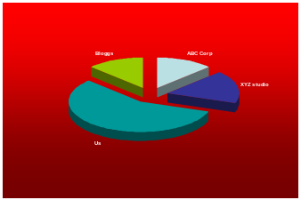
The Electric Catfish Studio
We Deliver Shocking Results
Graphic (line)
HOME
In the News
Catfish found in Moon rock fossil
Electric Catfish powers city on South Seas island
New Training Products announced by The Studio
Changes at the Electric Catfish Studio
After our recent merger with the leading consulting firm, Greenfile Developments Ltd, the team at The Studio was assured by Greenfile’s Research Manager Lon Bailey that investment and training budgets will be boosted and customer support enhanced. “Our targets are …
STUDIO
SERVICES
Read full story
PRODUCTS
GALLERY
DOWNLOADS
Read full story
Links
Content
Two web page designs for the price of 1!!
(offer expires 12-31-02)
Special
Offer!
Read full story
Our Market Share went through the roof last quarter
Read full story
Graphic
Read full story

Slide 7
Introduction to
Web Technologies

Slide 8
Technologies
The World-Wide Web (WWW)
Transmission –Uploads/Downloads
Multimedia
File Types

Slide 9
The Internet
The Internet came from a US Department of Defence network, then expanded to a (US) universities network
The “web” as we know it is the “World Wide Web”, the “www” that we put in front of the web page name
The Web is now the dominant part of the Internet

Slide 10
Inside the Internet
A loose connection of individual computers (called servers) in various networks
How it works:
Your information is broken into packets by your computer and sent via your service provider to the internet via many other computers

Slide 11
Internet Addresses
The Uniform Resource Locator (URL) or the web address is an acronym for the “true IP address”
For example:
URL= www.xyz.co.uk
IP address: 202.171.64.2
  The “name server” gets the IP address from the URL and then “connects” you

Slide 12
Transmission

Slide 13
Communication Paths
Your
Computer
MODEM
Hub/
Switch
ISP
The Internet
Routers
Servers
Servers
Servers
Servers
Network
Routers

Slide 14
Routers
Routers are the critical resource of the Internet
Routers check the input from your computer for their addresses and then sends the different packets to the destination through a variety of routes

Slide 15
Connecting to the Internet
Dial-Up
ISDN
“Broadband”
  ADSL: constrained by distance from exchange
  Cable: constrained by physical cable
  Wireless /Microwave: line of sight constraints
  Satellite: expensive at present

Slide 16
Transmission Speeds
Dial Up – 56Kbps (kilobits/second)
ISDN – integrated services digital network:128Kbps
ADSL – asymmetric digital subscriber line: upload 640Kbps / download 1.5Mbps
Cable / Wireless – similar to ADSL speeds – may be symmetric

Slide 17
Remember
8 Kilobits = 1 Kilobyte
Kilobyte (KB): used to describe file size
Kilobits: used by modem vendors to sell their kit (& to confuse us)
So
56KBps = 7KB/s so a “50K” file will take (in theory) 7 seconds to download – but Dial-up is usually slower than 56KBps

Slide 18
Main File Types
.htm – the basic “web” page – hypertext markup file format
.gif – compuserve graphic interchange format: very popular, small file size but limited in colours (256 in total)

Slide 19
HTML
HyperText Markup Language
This allows Links to different parts of a document (the hypertext)
The language is controlled by Tags (the markup)
For example:
<a href="Terms_of_Use.htm“>Terms
of Use</a>

Slide 20
More Language and Codes
DHTML – Dynamic HTML: more control of the page than HTML (uses Style sheets)
XHTML – Extended HTML: the final stage of HTML development
XML – Extended Markup Language – the next generation “unified” language will be used in Microsoft Office and other applications
  Current software: Sun’s Star Office

Slide 21
Multimedia
This is the sound / visuals (static & moving) that accompany the web site content
Benefits: “richer” web experience
Downside: slower transmission, the need for specific software (“plug-ins”)

Slide 22
Multimedia Jargon
Graphics:
  Bitmaps: photos & pictures-fixed resolution
  Vectors: scalable pictures-shapes/ designs
Examples:
Bitmaps: .gif, .png, .jpg (photos)
Vectors: .swf (requires Flash plug-in)

Slide 23
More Jargon
Sounds
  File types: .wav, .mp3, Shockwave, RealAudio
  Some will require plug-in players (Shockwave player, RealOne Player..)
  Others are supported by the Operating System e.g. Windows Media Player

Slide 24
Browsers
These form the interface between you and the Internet
There are several common browsers:
  Microsoft Internet Explorer (IE)
  Netscape Navigator (Netscape)
  Opera
Sites designed for one browser may not work the same way on other browsers

Slide 25
Software – Examples
Web Development Packages
  WYSIWYG: Adobe Go-Alive, Macromedia Dreamweaver, Microsoft Front Page, NetObjects Fusion
  Coders: Homesite Builder, HotMetal,
Office suite-Word Processing/ Graphics Packages
  Microsoft Word, Corel WordPerfect, CorelDraw etc

Slide 26
Software Options
The following are intended for guidance only
Difficulty (need to learn code)
Fusion
Word
Dreamweaver
HotMetal
Low
High
Word*
Dreamweaver
Fusion
Cost to purchase
HotMetal
* Assumes Office package is purchased primarily to carry out office suite applications

Slide 27
Software Capabilities
Low
High
Office-suite
software
Dedicated
Web Development
software

Slide 28
Additional Software
Hardly any single piece of software will allow you to develop a multimedia website
You are likely also to need:
Graphics/Photo editing software
Download Text software
Sound / Movies software

Slide 29
Graphics Software
These range from low cost (£30-£100) through mid-range (£100-£400) to expensive (£400+)
Examples:
Low Cost: Paintshop Pro
Mid-Range: CorelDraw, Flash, Fireworks, Illustrator, Photopaint, Freehand

Slide 30
What if you can’t draw?
Use :
Clipart
Stock Photos
Hire a graphic designer

Slide 31
Text Download
Adobe Acrobat:
This software allows the creation of a “pdf” file from almost any document
pdf files can be read by anyone with the free Acrobat Reader software

Slide 32
Sound
Sound files are created from specialist software, e.g. Director
They can be in the following formats: wav, mp3, Shockwave
Like Graphics, you can buy library of “sounds”

Slide 33
Movies
This can cost from mid-range to fully professional studio products
Movie File formats are:
  MPEG, AVI Quicktime and Real Video
They are viewed using:
  Windows Media Player, Quicktime, RealPlayer

Slide 34
Subcontracting Your Website
This saves you from the expenses/ time spent developing/ maintaining your site
But:
You may not get the site just as you want it
You may be overpaying
You may have hassles updating your site

Slide 35
Where to start?

Slide 36
You already have a reserved website!

Slide 37
Your Reserved Website
Member of the New Intermediaries have a Yahoo ID
This allows you to have some free space on the Yahoo Geocities web area
  http://uk.geocities.com/yourname/
You can use this site to promote your business or to test any web site you build

Slide 38
Web Site Usability

Slide 39
Purpose
What is the purpose of your site?
An E-brochure of your business?
Promoting your ideas?
A core part of your business offering?
An E-trading forum?
Your website can include
any/all of the above

Slide 40
Establishing Your Purpose
It is usually a good idea to “write” a website – draft layout and contents
You can do this from software like Microsoft Word
Suggestion:
Start with a written-down 1 minute description of what you do
Then write down what you want in your site

Slide 41
Designing the Site
Who is your audience?
What do they want or need?
How web-savvy are they?
You are designing for THEM not yourself, your colleagues or your friends

Slide 42
Design
The design of your site is dependent on its purpose
You need to decide:
  The desired style
  The desired capabilities
And match these to:
Your competence (or your designer’s competence!)
Your Resources (Time, Budget etc)

Slide 43
Designs
Designs can be:
Utilitarian
Professional
Fancy
State-of-the-Art
Avant-Garde
They can also be:
Cute
Cosy
Friendly
Professional
Cool

Slide 44
The “Look”
The Homepage
  Logo
  Colours
  Multimedia

Slide 45
The Homepage
This is the first page people will see when visiting your site
What impression should it give?

Slide 46
Top Tips for the Homepage
Create a very simple, easy-to -understand navigation system that doesn't take up too much space
Make sure your user has a way to search the site
Make the title of the page explanatory
At the top of the first page, add a one sentence tag line that summarizes what the user will find in the site

Slide 47
More Homepage Top Tips
Add a paragraph of the latest news in your business (this means maintenance)
Put your contact details on the homepage
Put your location (if relevant) on the homepage
Highlight Products and Service on the homepage

Slide 48
Functionality
This is also tied to your purpose
For example:
A professional site for a business consultant will not need the same level of latest technologies as a graphic arts company

Slide 49
Testing Your Site
Try it out on:
  Potential target audience
  People who are unconnected to you
  People who are not web-savvy
  Your Relatives
You want fresh viewpoints about your website

Slide 50
Ease-of-Use vs Visual Virtuosity
Ease-of-Use
Buttons are buttons
Menus are menus
Breadcrumb trails
Clear compatible colours
Stick to Web-Norms
Visual Virtuosity
Splash Page
Matt-pastel colours
(Flash) graphics, (Shockwave/Real) sounds, (Quicktime) movies
Unusual designs

Slide 51
Practical Usability
Page Width
Colours
Typeface
Page Length /Scrolling
Navigation (bars, buttons, image maps)
Page Names (description)

Slide 52
Page Width
The width of the page should match the resolution of the monitors of your target audience (all widths in pixels)
  <640x480 1% users
  640x480 5% users (old monitors)
  768x640 54% users (15/17” screens)
  1028x768 32% users (17/19” screens)
  >1028x768 8% users (19/21” screens)

Slide 53
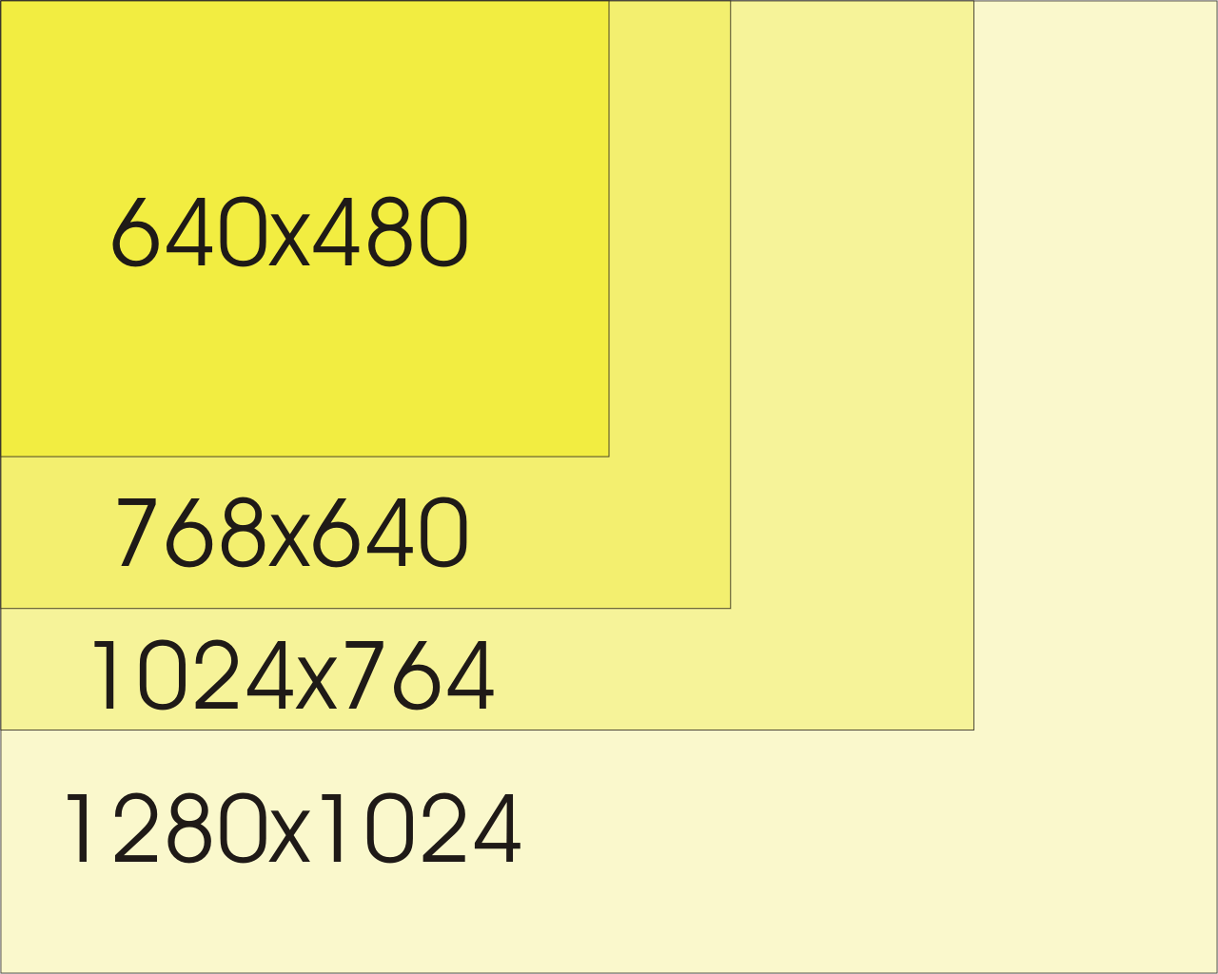
Screen Size Comparison

Slide 54
What happens if…?
A wider than viewable page will mean “scroll bars” and annoyed viewers
And
It won’t print too well!
A narrower than viewable page will have a great big white space on the right

Slide 55
Colours
Web standards:
Blue for unvisited links
Purple for visited links
All links are underlined
(and of course, these are uncool…)
Also
Men suffer more from colour-blindness than women – avoid Red-Green contrast combinations if possible if your target are men!

Slide 56
Typeface
Default typeface on your browser probably includes:
  Courier, Times, Georgina for serif
  Arial, Helvetica, Verdana for sans-serif
Type size – go for what is visible
12 pixel is small but saves space
IE/Netscape both have font size options

Slide 57
Page Length
You do not want people to scroll more than 1 or 2 pages downwards, (‘cause people get bored) so the limit is about 1200 pixels long
You can provide navigation buttons to “go to top” or jump to different parts of the page.

Slide 58
Navigation
“Nav bar” at top (horizontal) or on left (vertical)
Plain text links
Roll-over buttons – changes when you move the cursor over, or after you have visited
Flash buttons – plays mini-cartoons when it is highlighted
“Bread Crumb” trail

Slide 59
Navigation - Buttons
Every “button” has 4 possible states:
  Link – tells you it is a link
  Visited – tells you you’ve been there
  Hover – your mouse is over this link
  Active – you are clicking on this link
To have all 4 states present, you need
4 different images for each button!

Slide 60
Navigation Bar
This is made up a a series of links or buttons
It can be in a table or some software has special NavBars functions

Slide 61
Image Maps
This uses a picture as a navigation tool
The user clicks on various “hot spots” defined in the picture to go visit the links
Many software packages have special Image Map functions

Slide 62
“Bread Crumb” Trail
This is a bit more sophisticated to put into the site but can help the user find their way around the site
For example:
  Home->Products->Tutorial->Web Usability

Slide 63
Page Names
Choose something that says something about the page, like:
  http://www.electriccatfish.com/products/tutorial/web_usability.htm (dummy link –don’t try it)
Ideally, not like:
  http://www.amazon.co.uk/exec/obidos/tg/browse/-/468284/027-3679861-9124763

Slide 64
Laying Out a Website

Slide 65
Basic Layouts
Use whatever text layout you have and get Microsoft Word (or whatever software) to convert it into HTML
Or
Use the HTML Table function to create a layout

Slide 66
Tables
A Table in HTML is not really a table in the conventional sense
It is a page layout setting that allows any combination of words, graphics to be used in different sized cells

Slide 67
Fancier Layout: CSS
Cascading Style Sheets
These allow precise definitions of almost any element on a webpage:
  Typeface
  Layout (using Layers instead of Tables)
  Backgrounds
CSS are part of Dynamic HTML (DHTML)

Slide 68
Layout: Frames
Frames are used when you want one part of the page to stay constant whilst others are changed
A framed page comprises framesets and each frameset is a separate page
They are not the easiest things to implement (and I’ve never used them)

Slide 69
Layout: Templates
For when you have lots of pages and they all look more or less the same
Also very useful for the “footer” or header logo/graphics

Slide 70
Accessibility
Your website may be visited by people with disabilities, some of whom may have a “web reader” – software that reads the webpage to them
Use the “ALT” text tag to fill in details about the links and graphical elements
Note: Netscape V6 & 7 currently do not implement the ALT tag

Slide 71
Other Content
Some other necessary
content to consider:
Copyright
Contacting You
Terms of Use
Privacy Policy

Slide 72
1. Copyright
This protects your content only in the sense that you declare the contents of your site yours
Usually shoved in the page footer

Slide 73
2. Contacting You
This can be useful in getting feedback and comments without the hassle of a establishing mail-send routine
Have a link that says: Email Us or Contact Us and linked to: mailto:chief_catfish@electriccatfish.com
  (dummy web link- don’t try it)

Slide 74
3. Terms of Use
This is getting into big-time liability limitation
This can state that the contents of the site is not there to serve any purpose or use
This can also state that the site operator accepts no liability from use and the user accepts the Terms by visiting the site

Slide 75
4. Privacy Policy
If you collect details of people visiting your site, you will need to declare how the information is/will be used
  A declaration that says the information will be kept confidential unless it is needed to comply with the law is usually sufficient

Slide 76
Additional Declarations
You may wish to consider the following declarations as well:
  Age
  Takedown
  About Us

Slide 77
Age & Takedown
Age
You may wish to put in a clause that the contents of the site is not designed for people under a certain age
Takedown
This is a statement that says if you inadvertently infringed any copyright, then you will take down the material concerned provided that you are notified formally

Slide 78
About Us
It is useful to have a section about your organisation, yourself and anything else about the philosophy of your business

Slide 79
Other Design Considerations
Updating and Maintenance
Collaboration
Growth
Links to Other Sites

Slide 80
Updating/Maintenance
If you put a date on the site, it immediately dates it (and you will need to keep it updated)
If the website is to be updated and maintained by you (alone) then you can more or less do what you want

Slide 81
Collaboration
The easy way is to buy the right software to allow other people to change/add to the content without changing the look and feel of the site – e.g. Macromedia Contribute
The hard way is to get people to send the input to you and you hand insert it

Slide 82
Teamware
This is another software option for collaboration:
  Macromedia Sitespring
  Adobe Design Team
  Microsoft Sharepoint Team Services
These software allows groups to work together on a website

Slide 83
Growth
When your site gets bigger and more complex - what do you do?
When you have a huge database of material and people can search for information that meets their particular criteria, you will need a Dynamic Website
  For example: amazon.com

Slide 84
Dynamic Sites
They are interactive sites and will change its contents with your needs
Dynamic sites are often used when there is a lot of data to search through and searches can encompass several variables

Slide 85
Finding Your Site

Slide 86
Finding Your Site
Is your site a freestanding sales site (like www.amazon.co.uk)?
Is it going to be a brochure that YOU point people to?
Will it be passed through word-of-mouth?

Slide 87
1. Sales Site
Easy to remember name
Loads of key words, description
Links
Paying for search engine registration
Advertising your link on Google and other sites

Slide 88
2. Brochure Site
People will approach the site once they know of you
Names that are easy to remember & spell and not full of weird punctuations
Avoid:
www.Uly_Ma.com or
www.wearethecheapestconsultancy.com

Slide 89
3. Word-of-Mouth Site
Easy to remember name
Try to buy up all the domain name extensions (.com / .co.uk / .biz …)
Avoid:
Weird spellings: fone.com, batz.net
Awkward page names:
  www.bloggs.com/dogfish/dogfish_gallery/-/468284/027-3679861-9124763

Slide 90
Domains and URLs
Domains are the letters at the end of the URL
They are to show the location and type of organisation that owns the site
.uk .fr .dk are nations as is .tv
.ac .com .co .net .biz are types of organisations
Since the Americans invented the web, the .us designation is not used!

Slide 91
Site URL
An easy-to-remember name is ideal
  www.bbc.com is easy to remember but the Boston Brick Company had it first…
Some URLs are not that great:
  www.freeserve.joebloggs24uk.co.uk or
  www.greenfile.demon.co.uk
You can register any name so long as nobody else is using it

Slide 92
URL Problems
However, others can use a different derivation of the same name:
  greenfile.net (my site)
  greenfile.co.uk (this is a dormant site)
  greenfile.com (this is a USA members-only site)
You can buy up all the possible domain names but it will cost you!

Slide 93
Finding Your Site
Search engines look for Keywords and Description in the “Meta Tags” part of your site
Meta Tags are in the page header and you do not see them in a browser
They need to be coded in or done via software

Slide 94
Promoting Your Site
Register with Search Engines
  DIY
  Pay someone
Links to Other Sites
  List of Links
  Relevant Links

Slide 95
Other Stuff

Slide 96
Links to Other Sites
Some sites disable the “Back” function on the browser so any link to a site in the same window will mean your site is gone
Make sure the link you have for other people’s site opens in a new window
This will mean that your site will always remain on screen

Slide 97
Web Search
There is little reason to put a “search internet” link in your homepage – people who got to your site probably has a more professional search engine, so why waste the precious space on your homepage?

Slide 98
Site Counters
You need to find out whether your visitors care if they are the 3rd or 14,000,045 visitor to your site.
It can add some charm, but it can also look like a hobby or fan site.

Slide 99
Splash Page
Splash pages are very popular with vendors of specific goods – like cars, hi-fi or electronics
They use fancy graphics (movies), music (melodic stuff not beeps!)
They also take a long time to download and can become a pain if you visit the site more than once

Slide 100
Learn from Others
Visit the sites of companies you admire or heard of
Look at how their sites are structured and whether the layout is attractive
Check their usability
Think about why their site is designed like that

Slide 101
Places to Visit
The FT 100 company sites
A software vendor’s site
A hardware vendor’s site
A High Street store’s site
A Government website
A fan website

Slide 102
My Experiences in Web Design

Slide 103
Website Version 1
Was horrible!
The text looked awful
The graphics are too big
The layout was boring
And
I was too ambitious

Slide 104
Version 2
Was slightly better in terms of looks
I had not planned it well
Still too ambitious
Too complex in terms of surveys and jump menus
Never got uploaded because it was too difficult to put together

Slide 105
Version 3
Put together as a cut-down temporary version of 2nd website
Much simpler in layout and content
Got uploaded after 2 days of work on version 2

Slide 106
Version 3.5
An extra website (from a contract) was added
This has a completely different style and content
Matching the 2 sites was okay but occasionally problematic

Slide 107
Version 4 - Planned
Much “cooler” -i.e. probably:
  Difficult to develop (trying out new techniques)
  Not so hot on the usability (grey on grey may look good, but wrecks your eyes)

Slide 108
Suggested Exercise
Prepare a simple website using:
Microsoft Word (other WP package) with clip arts and links to the NI website plus email to you
Upload to your Yahoo Geocity website
Use your browser to have a look and try the links & email function

Slide 109
Contact Us
Uly Ma
Greenfile Developments Ltd
Tel: 0796 619 4255
Email: uma@greenfile.net
Web: www.greenfile.net

